Slide 1
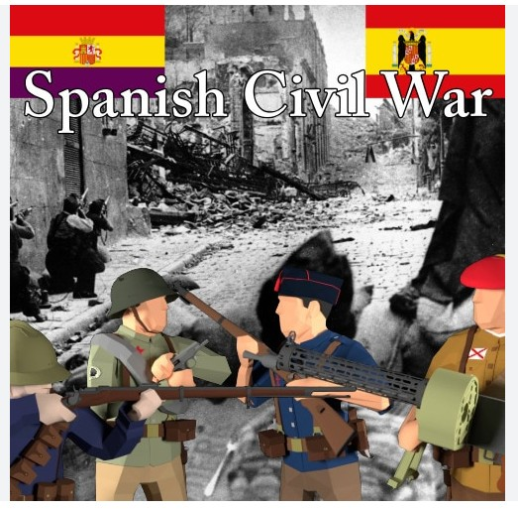
Welcome!
Bienvenidos!

Slide 2
Agenda 20th November 2024
10.00am – 11.00am
Introduction: context of the war (before 1936)
11.00am – 11.30am
Break
11.30am – 12.15pm
Chronology of the war (1936-1939)
12.15pm- 12.30pm
The aftermath of the war

Slide 3
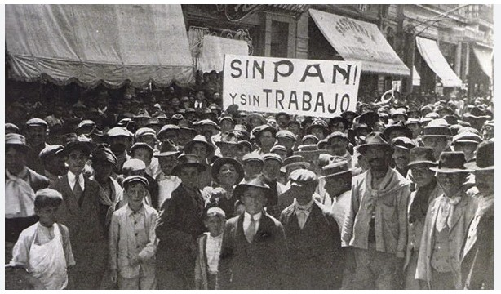
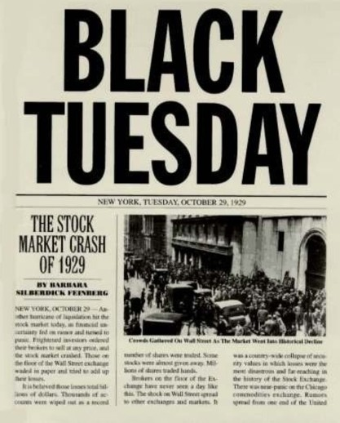
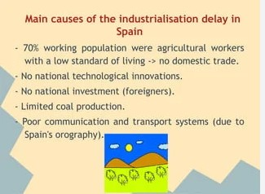
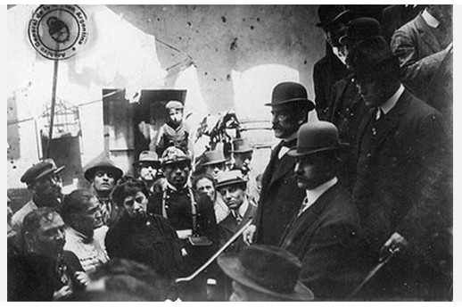
Strikes – No bread and no jobs
Delay of industrial revolution
Stock market crash 1929
Wealth and poverty

Slide 4
- At the same time, King Alfonso XIII (who reigned from 1886 to 1931) was very weak and unable to resolve all the conflicts. Because of his inefficiency and ineptitude, he allowed Primo de Rivera to rise to power as dictator (1923). Alfonso XIII was the great-grandfather of Felipe VI, the current king in Spain.
- Spain was immersed in economic chaos. Social discontent, strikes that increased opposition to the dictatorship and growing disagreements in the ranks of the army due to the arbitrary actions of Primo de Rivera caused his popularity to plummet. Older, ill and with little social support, in January 1930 he presented his resignation to Alfonso XIII.

Slide 5
- In 1930, republicans, socialists and other opposition groups signed the Pact of San Sebastian, with the intention of overthrowing the monarchy and establishing a democratic regime.
- In 1931, the elections were won by a landslide by the Republican and Socialist candidates, which precipitated the departure of King Alfonso XIII into exile and the proclamation of the Second Republic on 14 April 1931.

Slide 6
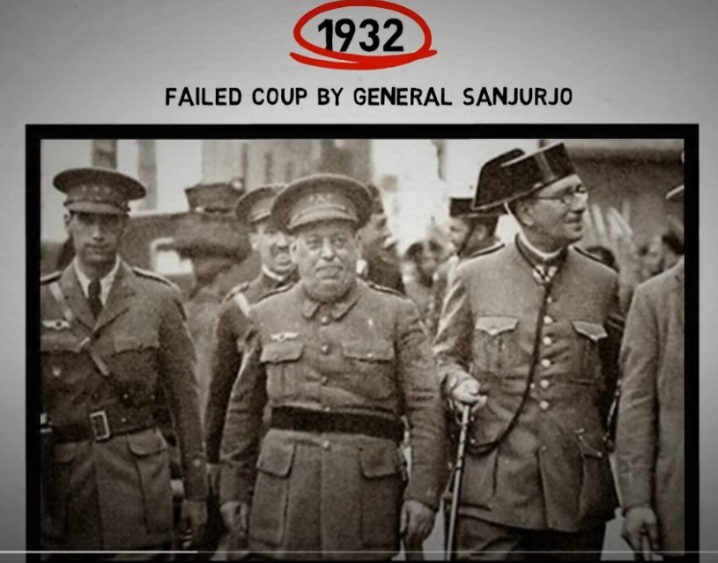
- There was a failed coup attempt by General Sanjurjo, in 1932, in his own words "to try to restore order and prevent the left turn that was leading Spain to anarchy.“
- Historians refer to this attempt as “La Sanjurjada”, where local rebel commander general Jose Sanjurjo took control for some 24 hours but acknowledged defeat when faced with resolute governmental response

Slide 7
- In 1933, the Catholic right wing of the CEDA (Spanish Confederation of Autonomous Right-wing Parties) headed by José María Gil Robles and the Republican center-right of Alejandro Lerroux won the elections.
- These were the first elections in which Spanish women were allowed to vote.

Slide 8
- In October 1934, an uprising in Asturias against the Lerroux government (a revolutionary strike by Asturian miners) took place. Its suppression resulted in more than 1,300 deaths, more than 3,000 wounded and 30,000 arrests. This event increased the tension, and the existing political and social instability.

Slide 9
- A left-wing group called the Popular Front won the elections in February 1936, forming a government headed by Manuel Azaña. Political and social tension increased with a confrontation between a strongly anticlerical revolutionary left and a right based on tradition and religion.

Slide 10
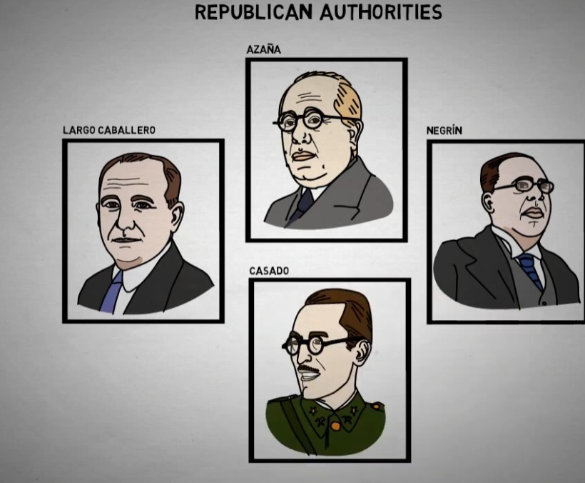
On the Republican side, the supreme authority until the end of the war was Manuel Azaña, president of the Republic (leader of the Republican Left party). Until May 1937, the first stage of the war, the government was headed by Largo Caballero (leader of the Socialist Party), replaced by Juan Negrin. At the end of the war, in March 1939, the Republican Colonel Casado staged a coup against Negrin, ordering the Republican capitulation to General Franco's army.

Slide 11
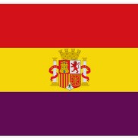
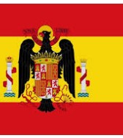
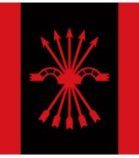
- Between February and July 1936, there were a total of 189 incidents and 262 deaths, of which 112 were caused by the intervention of law enforcement. Of the 262 victims, 148 were militants of the left, 50 of the right, 19 of the law enforcement forces and 45 unidentified.

Slide 12
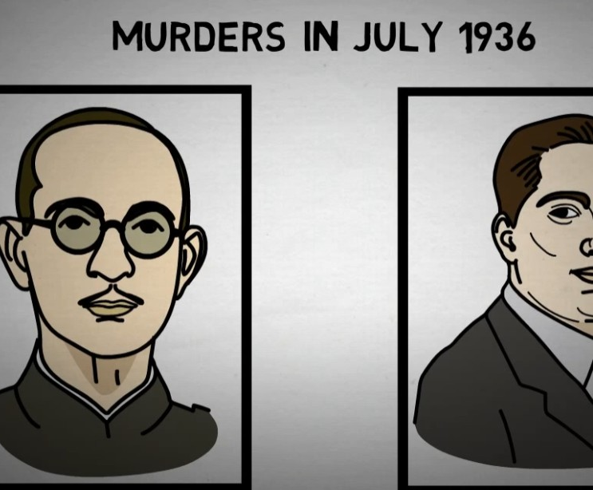
- On July 12, 1936, Lieutenant Jose Castillo, well known for his leftist activities, was assassinated (probably at the hands of Falangists). Reprisals were not long in coming and on July 13, 1936, Jose Calvo Sotelo, parliamentary leader of the opposition to the Popular Front, was killed.
- Experts believe these events, added to the climate of instability and disorder caused by the previous months, were the trigger for the coup d'état that had been brewing since March 1936.

Slide 13
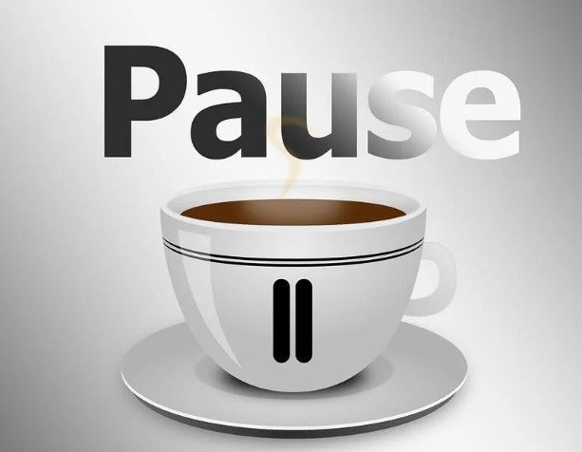
See you all back in 30 minutes!!

Slide 14
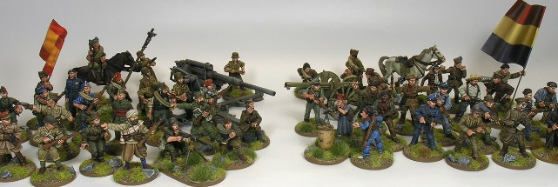
Chronology of the war (1936-1939)

Slide 15
- Numerous military officers and commanders, led by General Mola and General Franco participated in the uprising.
- General Mola – Pamplona
- General Yagüe –Extremadura
- General Queipo – Seville
- General Franco - Melilla
"We must spread terror... we must create a feeling of dominance by eliminating without scruples or hesitation all those who do not think like us."
General Mola Note: July 19, 1936, one day after the military uprising and the beginning of the civil war.

Slide 16
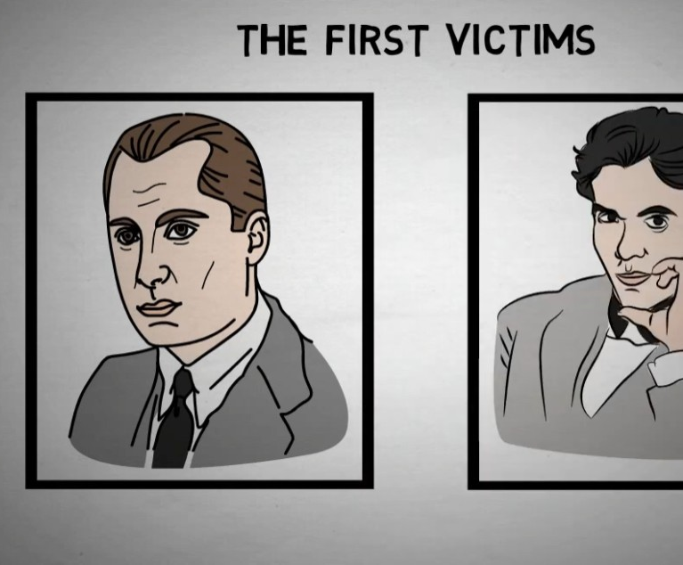
- In November 1936, lawyer and MP Jose Antonio Primo de Rivera, leader of the Falange and son of General Primo de Rivera, was executed in the Alicante prison. In August of the same year, the poet and free thinker Federico Garcia Lorca had been assassinated. in Granada.

Slide 17
The whereabouts of his remains are unknown.

Slide 18
German Condor Legion and Italian volunteer troops
U.S.S.R. - Union of Soviet Socialist Republics

Slide 19
In response to the non-interventionist policy of the main Western democracies such as France, the United Kingdom and the United States, the so-called International Brigades were created, controlled by the European and North American communist parties, made up of some 40,000 anti-fascist volunteers from around the world who fought on the Republican side. They played an important role, especially in the defense of Madrid and the battle of Teruel. They left Spain in October 1938. Experts believe that this war was a kind of rehearsal for World War II.

Slide 20
- 1937 January: Republicans resist in Madrid, winning the battle of Guadarrama and creating a Republican front at the university. Madrid will be constantly besieged by General Mola from the north and General Franco from the south.

Slide 21
-26 april 1937 - Guernica bombing by German planes, completely destroying the village. 70% of the buildings were destroyed. This event is believed to have been part of training for the German troops (allowed by Franco), preparing for what was about to come a few years later (World War II)
https://www.youtube.com/watch?v=-Kug6zwinbY

Slide 22
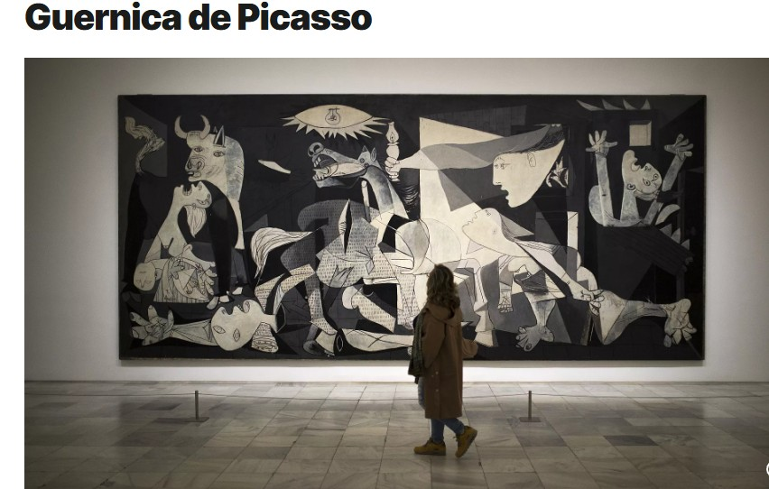
The Guernica, painted by Pablo Picasso in Paris between May and June 1937, is currently in the Reina Sofia Museum in Madrid.

Slide 23
- At the end of 1937, the nationalists win the battle of Teruel and manage to reach the Mediterranean, dividing the republican territory in two.

Slide 24
The Battle of the Ebro took place between July and November 1938: the bloodiest and most decisive battle of the war, which ended with a definitive defeat for the Republican side.
https://www.youtube.com/watch?v=Rd2G3DGYa-A

Slide 25
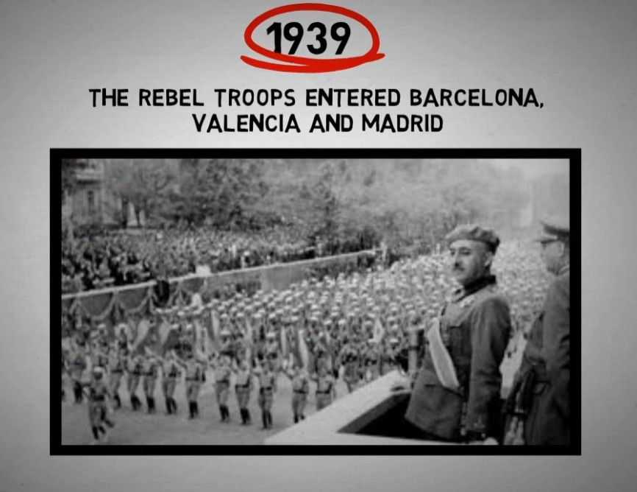
During the first quarter of the year 1939, the main cities controlled by the republican side were falling one by one. Barcelona, ​​Valencia and finally on March 28, the national troops conquered Madrid. Three days later, April 1st, General Franco declared the end of the war.

Slide 27
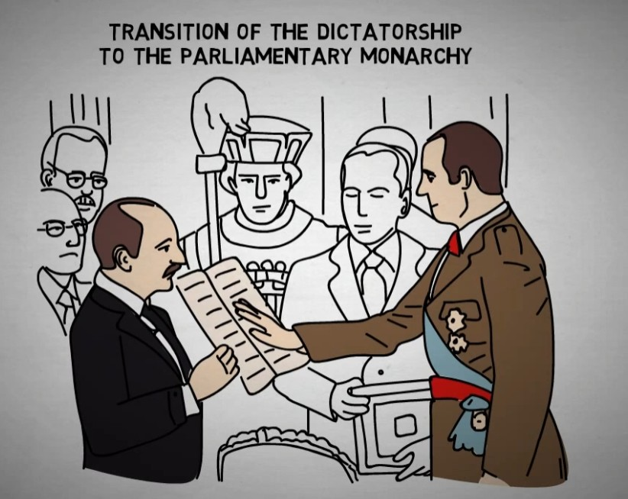
- 1975 Year of reconciliation between “winners and losers” (November 20th Franco’s death and November 22nd coronation of Juan Carlos I as king). Transition to democracy with the approval, by an overwhelming majority, of the 1978 Spanish Constitution.

Slide 28
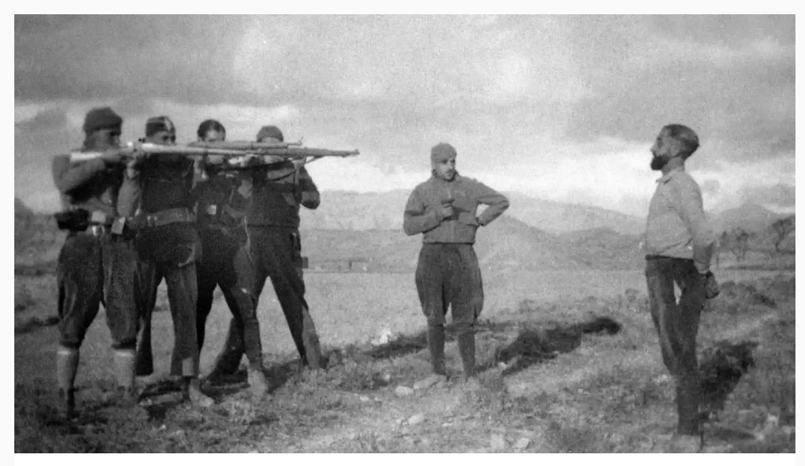
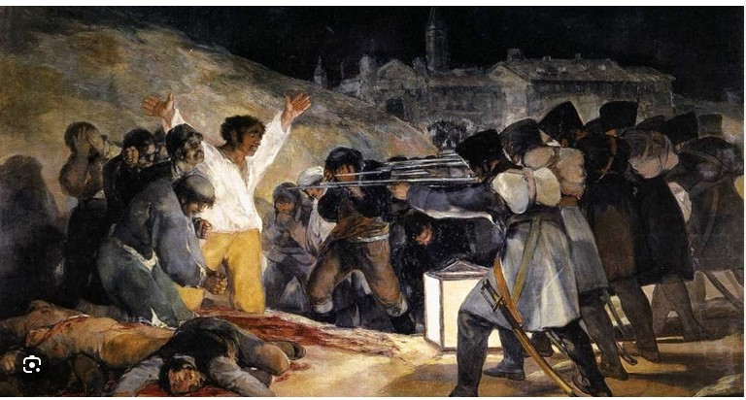
General information
There was massive repression on both sides.
On the Nationalist side, it was mainly directed against workers and social activists, but also against some intellectuals, such as Federico García Lorca. This repression was organized by the military authorities and lasted throughout the conflict.
On the Republican side, the groups that suffered violence were mainly priests and the wealthy classes. These acts took place at the beginning of the war and were carried out, in most cases, by uncontrolled groups.
- The Catholic Church supported the uprising, calling the war a "crusade" or "holy war" in the name of religion, giving the Nationalist side the significant religious legitimacy.
- Foreign artists and intellectuals supported the Republican cause. Ernest Hemingway worked as a reporter and photographer during the conflict and George Orwell fought on the Republican side, although he was disappointed by the rivalry within the ranks of the left.
- In fact, one of the reasons for the Republican defeat was the internal divisions between socialists, communists and anarchists.

Slide 29
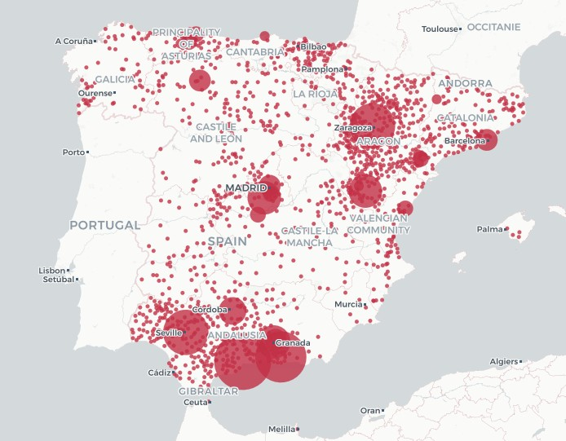
- Spain is the second country in the world, after Cambodia, with the highest number of victims of forced disappearances whose remains have not been recovered or identified, according to the association Judges for Democracy (more than 114,000 missing persons)
Map - The Ministry's data shows more than 120,000 victims exhumed in 2,591 graves spread throughout the country. Andalusia, Aragon and Asturias are the regions with the highest number of identified (mass) graves.

Slide 30
“It was in Spain that [my generation] learned that one can be right and yet be beaten, that force can vanquish spirit, that there are times when courage is not its own recompense. It is this, doubtless, which explains why so many, the world over, feel the Spanish drama as a personal tragedy.” A. Camus
The silence of Others
https://www.youtube.com/watch?v=68c_E5fiaD0

Slide 31
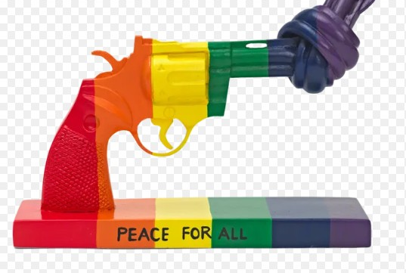
Sources:
- https://historyofspain.es/
- https://humanidades.com/la-dictadura-de-primo-de-rivera/
- https://encyclopedia.ushmm.org/
- UNED Dénia

